Slide 1
2021-2022 CAA Basketball Coaches Meeting

Slide 2
Agenda
NOTE:
To change images on this slide, select a picture and delete it. Then click the Insert Picture icon
in the placeholder to insert your own image.
Commissioners
CAA Rules & Regulations
Uniforms
Communication
Evaluations

Slide 3
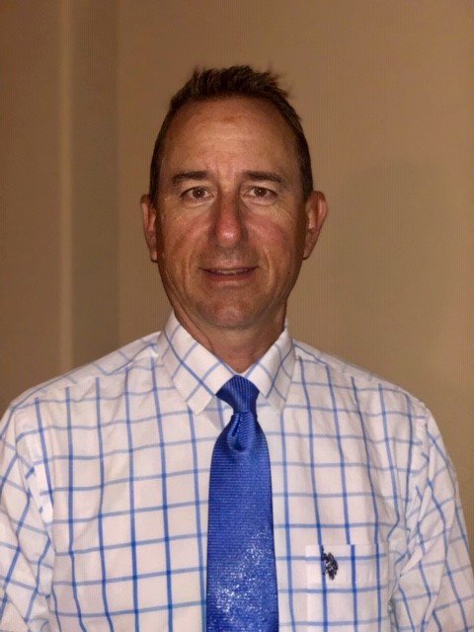
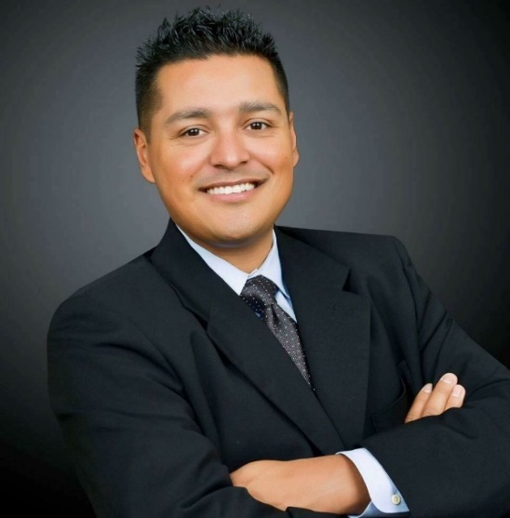
CAA Basketball Commissioners
David Bray
602-980-7615
davidbr@ping.com
Anthony Estrada
480-369-6430
Estrada_Anthony@Hotmail.com

Slide 4
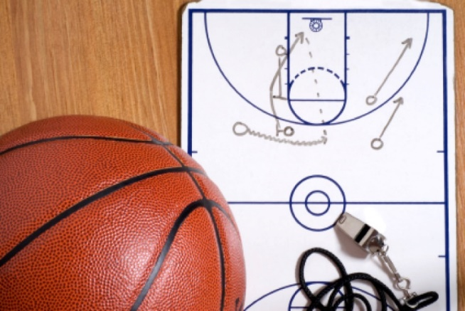
Commissioners Role
To serve as a mediator between schools and officials.
Scheduling Changes: game days, times or edits contact: caascheduling@gmail.com
Issues with Officials
Improperly enforcing rules, tardiness, hustle, professionalism.
Venue issues
Opposing schools
Unruly Fans

Slide 5
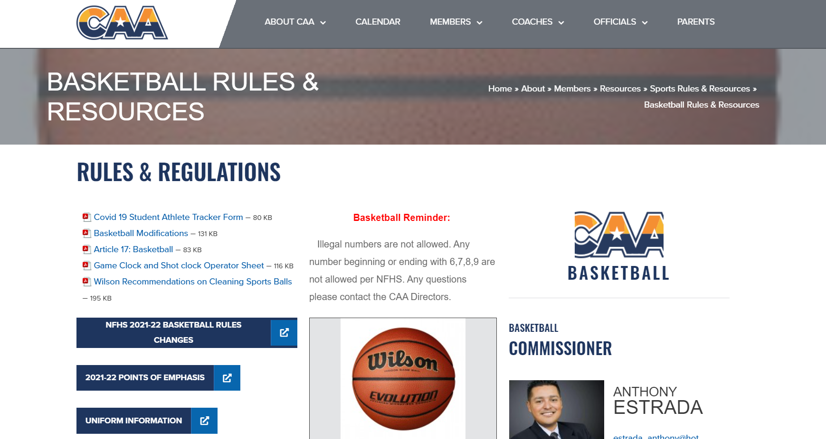
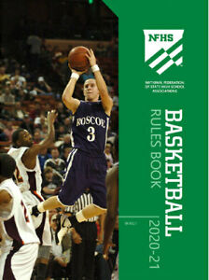
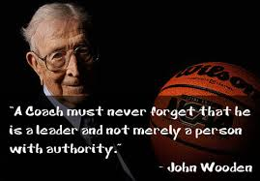
CAA Rules & Regulations
Azcaa.com
-Coaches
-Sports Rules and Resources
Information regarding supplemental rules

Slide 6
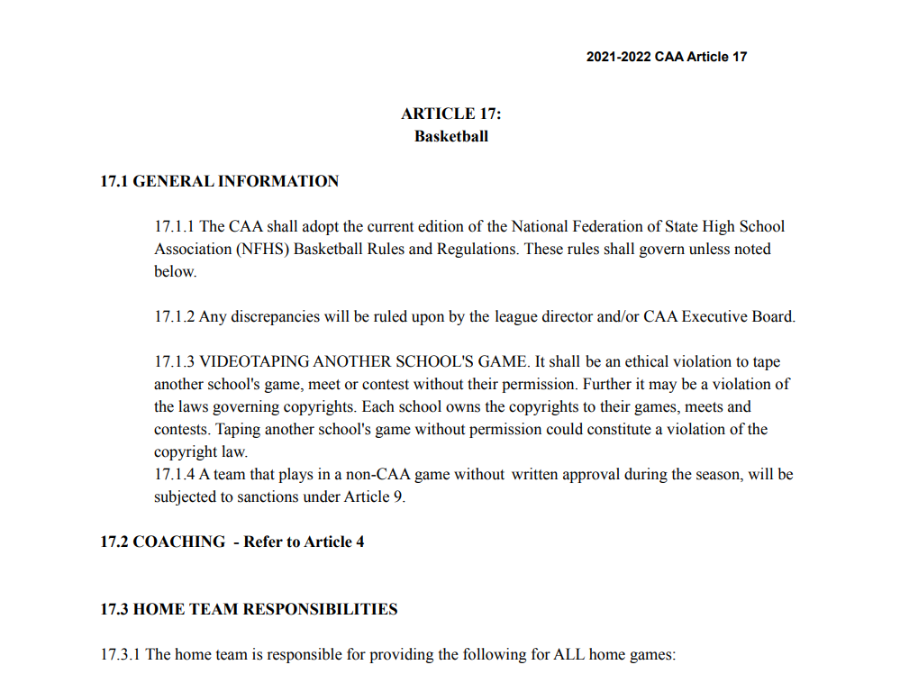
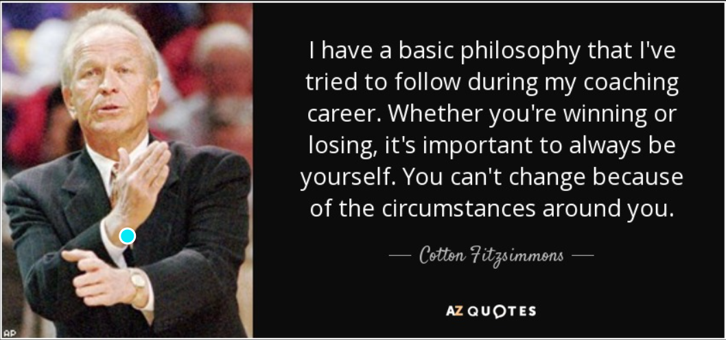
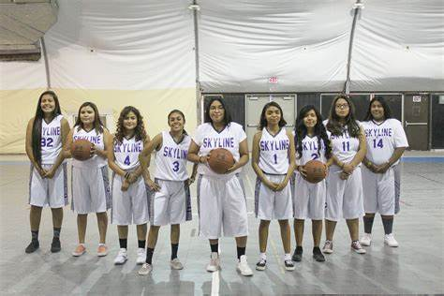

Slide 7
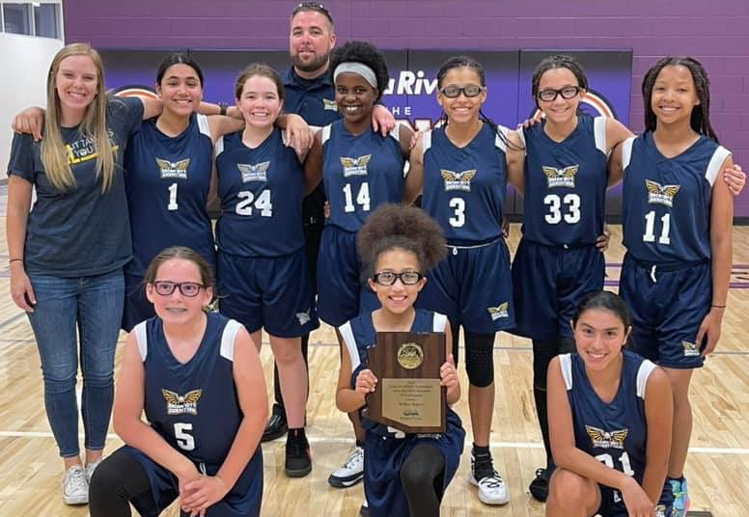
CAA Jr High Basketball Specific Rules
10 minute grace period w/communication
Mandatory 10 minute warm up
Four -6 Minute Quarters (Stopped Clock)
Overtime- 3 Minute (Stopped Clock)
Halftime –5 Minutes
Bonus Free Throws at 7 & 10 in each half and 5 fouls to foul out
NO JEWLREY!!!
Need 5 players to start a game can end with 1
Three Full Time Outs & Two 30 second Time Outs (HS & JR High)
Time outs carry over into overtime & they receive 1 additional Full Time Out Per OT
No Press if winning by 20 points any point in the game.
Mercy Rule 30 points. Second Half only, Stops on Timeouts, Injuries, Technical Fouls or if losing team ties and/or takes the lead.

Slide 8
NFHS 2021-2022 Basketball Rule Changes
Shot Clock:
2-14 (NEW): By state association adoption, effective with the 2022-2023 season
3-5-4e (NEW): Head coverings worn for religious reasons shall not be made of abrasive or hard materials
The MANUAL- Part 3 SIGNALS 36 & 37: Eliminate signal #37 (Team Control Foul) Maintain use of signal #36 for Player Control and Team Control Foul

Slide 9
Equipment & Apparel

Slide 10
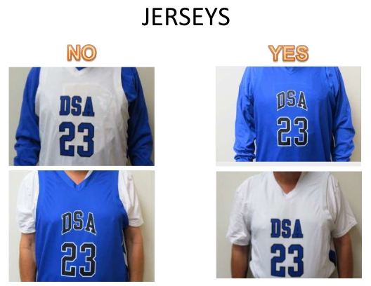
Jerseys, Undershirts and Shorts
Undershirts must be the same color as the dominate color of the torso of the jersey.
Short or long sleeve undershirts are okay as long as length of sleeves is the same. May not be cut off, sleeves must be hemmed.
ALL Shorts must match, do not have to be same color as torso.
NO CAMOFLOUGE JERSEYS
Jerseys to be tucked in.

Slide 11
NO JEWELRY!!!!!
Boys High School and Jr. High to use 29.5” Regulation Ball
Girls High School, Jr High and all Elementary to use 28.5” Ball
Wilson is the preferred official game ball
Illegal Numbers are okay in Jr. High & Elementary
Numbers that can not be reported with one hand, 62, 77, 94, etc.

Slide 12
Communication is Key
Questions to officials should receive an answer
Receive it and turn the page
Statements are merely statements and will be ignored
FOUL! Travel!!! That’s Over the back… Reaching!!!!!!!!!!
Utilize Rulebook verbiage

Slide 13
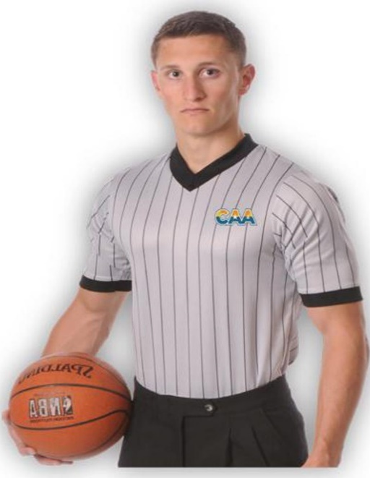
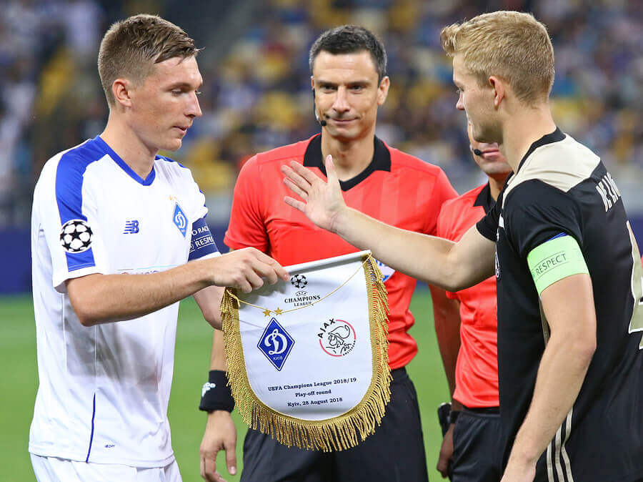
Expectations of Officials to Coaches
Be on time
Wear proper uniform
Conduct Captains Meetings ( 1 Captain per team)
Meet Coach (No official hand shake)
Enforce the rules as written
Communicate

Slide 14
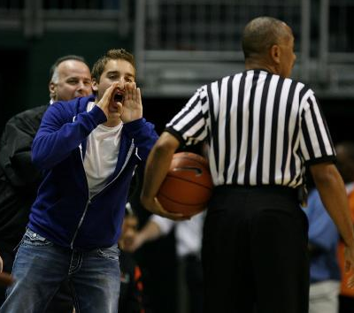
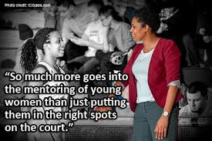
Expectations of Coaches to Officials
Lead by example
Communicate to officials, ask questions
Fill out scorers book and provide qualified adult to keep score/book
Stay within coaching box and utilize appropriate language
Responsible for fan behavior

Slide 15
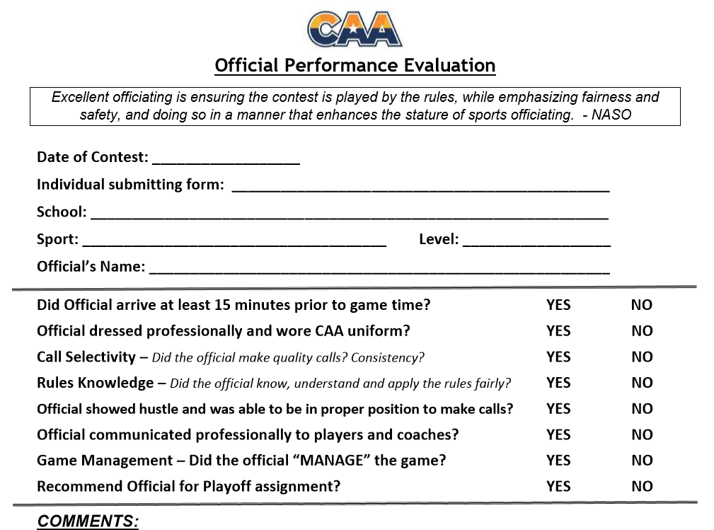
AZCAA.com
-Members
-Forms
-Game Day Forms
Officials Performance Evaluation

Slide 16
WESLEY ROUSE with Phoenix Suns and Mercury

Slide 17
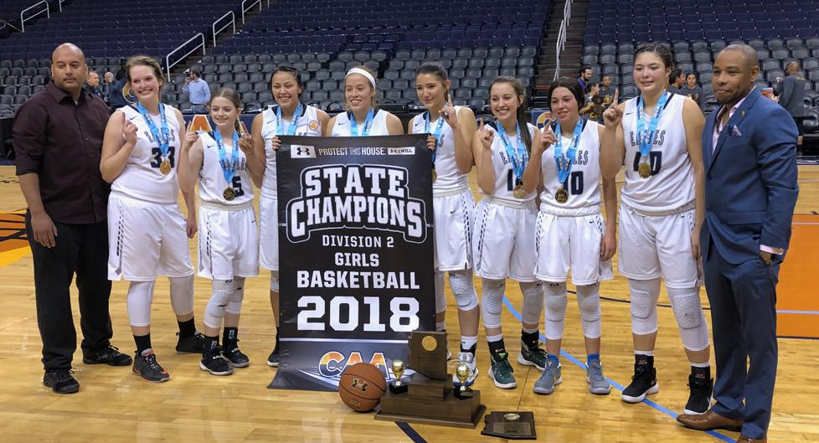
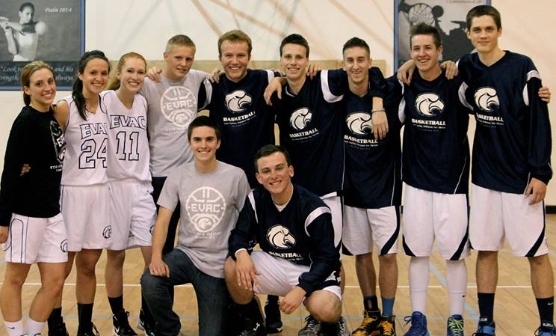
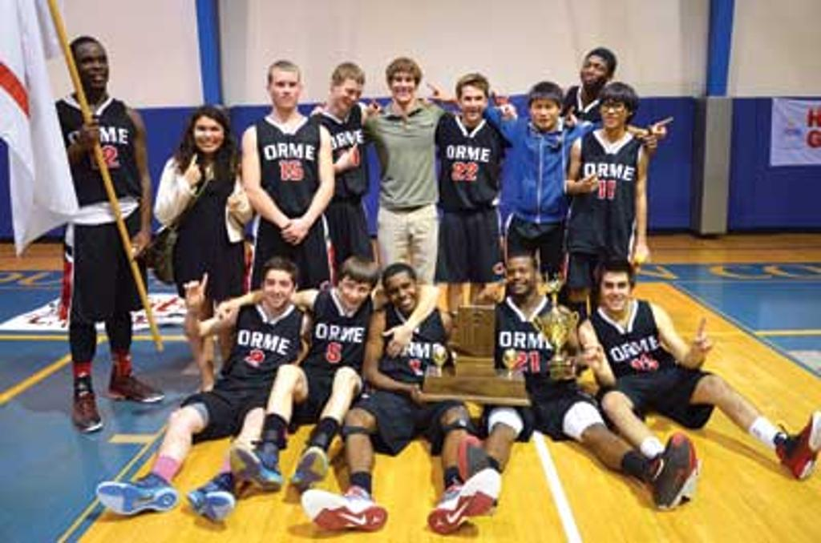
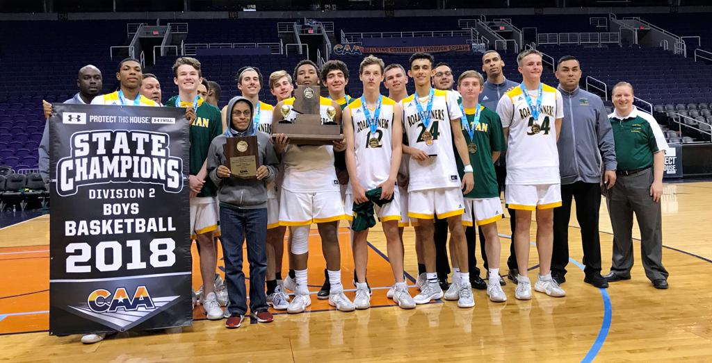
THANK YOU COACHES FOR ALL YOU DO!!!

Slide 18
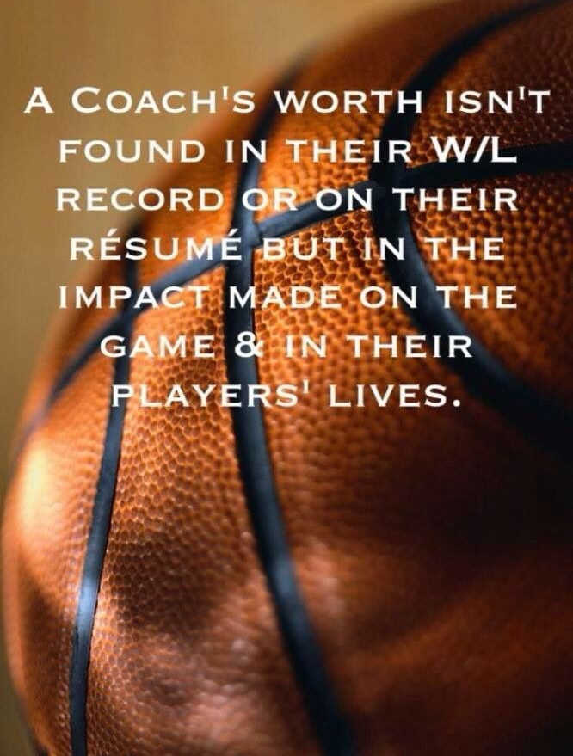
On Behalf of the CAA,
Any Questions?

